Slide 1
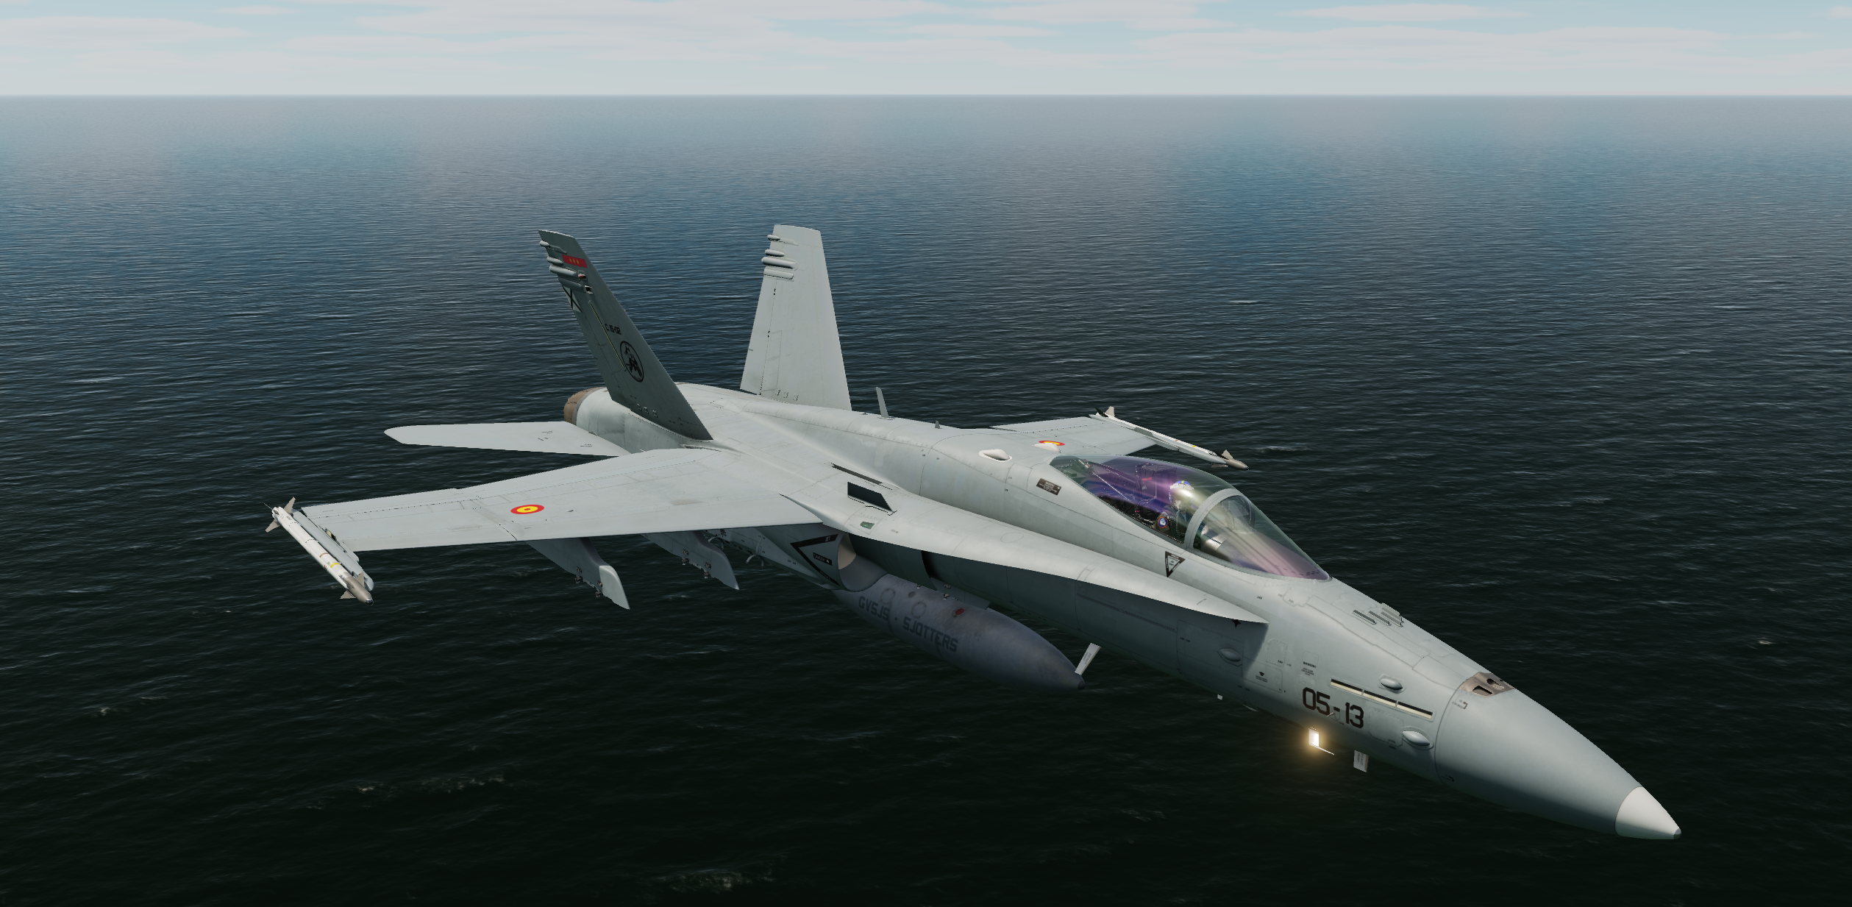
CAUCASIAN WAR 23/04/2021

Slide 2
ROLL CALL
Flight | Pilot
Tomcat1-1 | Charlie
Tomcat1-2 | Tulkas
Viper1-1 | Magoo
Viper1-2 | Abigor
Hornet2-1 | Chichowalker
Hornet2-2 | Raus
Hornet2-3 | Jaja
Hornet2-4 | Caldero
Warthog1-1 | Astiles
Warthog1-2 | Xifu
Cobra1-1 | Jason
Cobra1-2 | Pacotre

Slide 3
FORCE COMPOSITION
TOMCAT1 – 2xF-14B SWEEP (6,0,2,+)
VIPER1 – 2xF-16C ESCORT/SEAD (4,0,2,+) 4 AGM-88
HORNET1 – 3xF/A18C DEAD (4,0,2,+) 1 AGM-88C + 4 GBU-38
COBRA1 – 2xAV-8 STRIKE (0,0,1,+) 4 GBU-38 + 1 SIDEARM
WARTHOG1 – 2 A-10CII BA – GBU-38 RECOMMENDED
OVERLORD – E3C C2
ARCO – KC-130 AAR
TEXACO – KC135 AAR

Slide 4
COMMAND INTENT
DEGRADE/DESTROY GORI CONTROL POINT ATTACKING TROOPS THERE AND AIR DEFENSE FACILITES:
VIPER1: SA-10 (WATERBUCK)
HORNET1: SA-10 (WATERBUCK)
COBRA1: GORI DEFENDERS

Slide 5
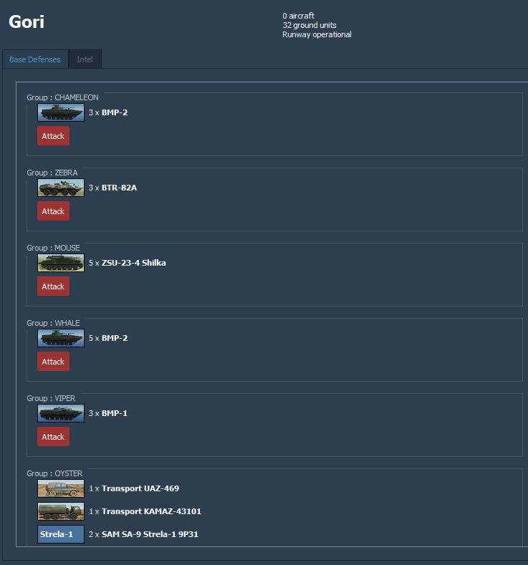
TARGET OVERVIEW

Slide 6
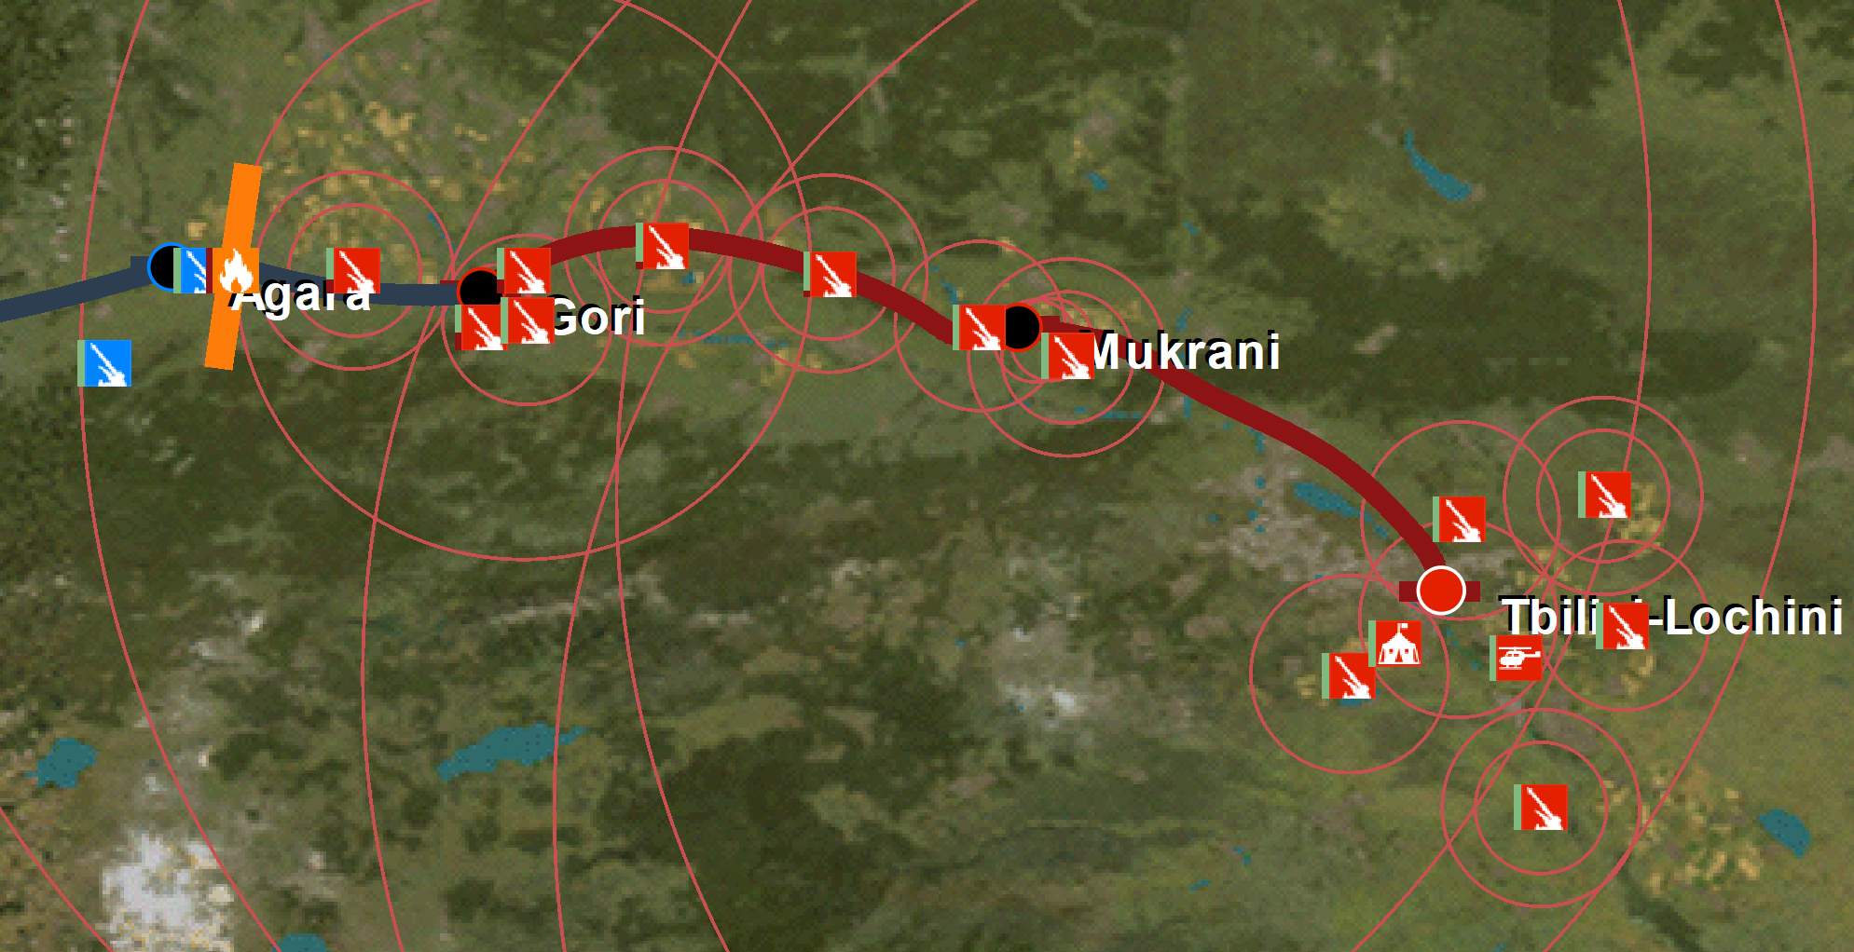
TARGET AREA
WATERBUCK

Slide 7
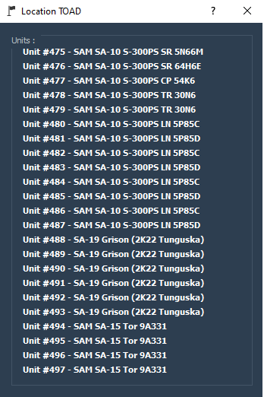
TARGET AREA
WATERBUCK

Slide 8
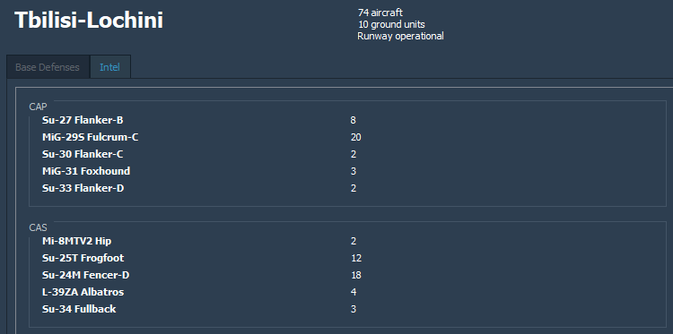
AIR TO AIR THREATS
N
B/E
TBILISI
B/E: 110/45
GORI

Slide 9
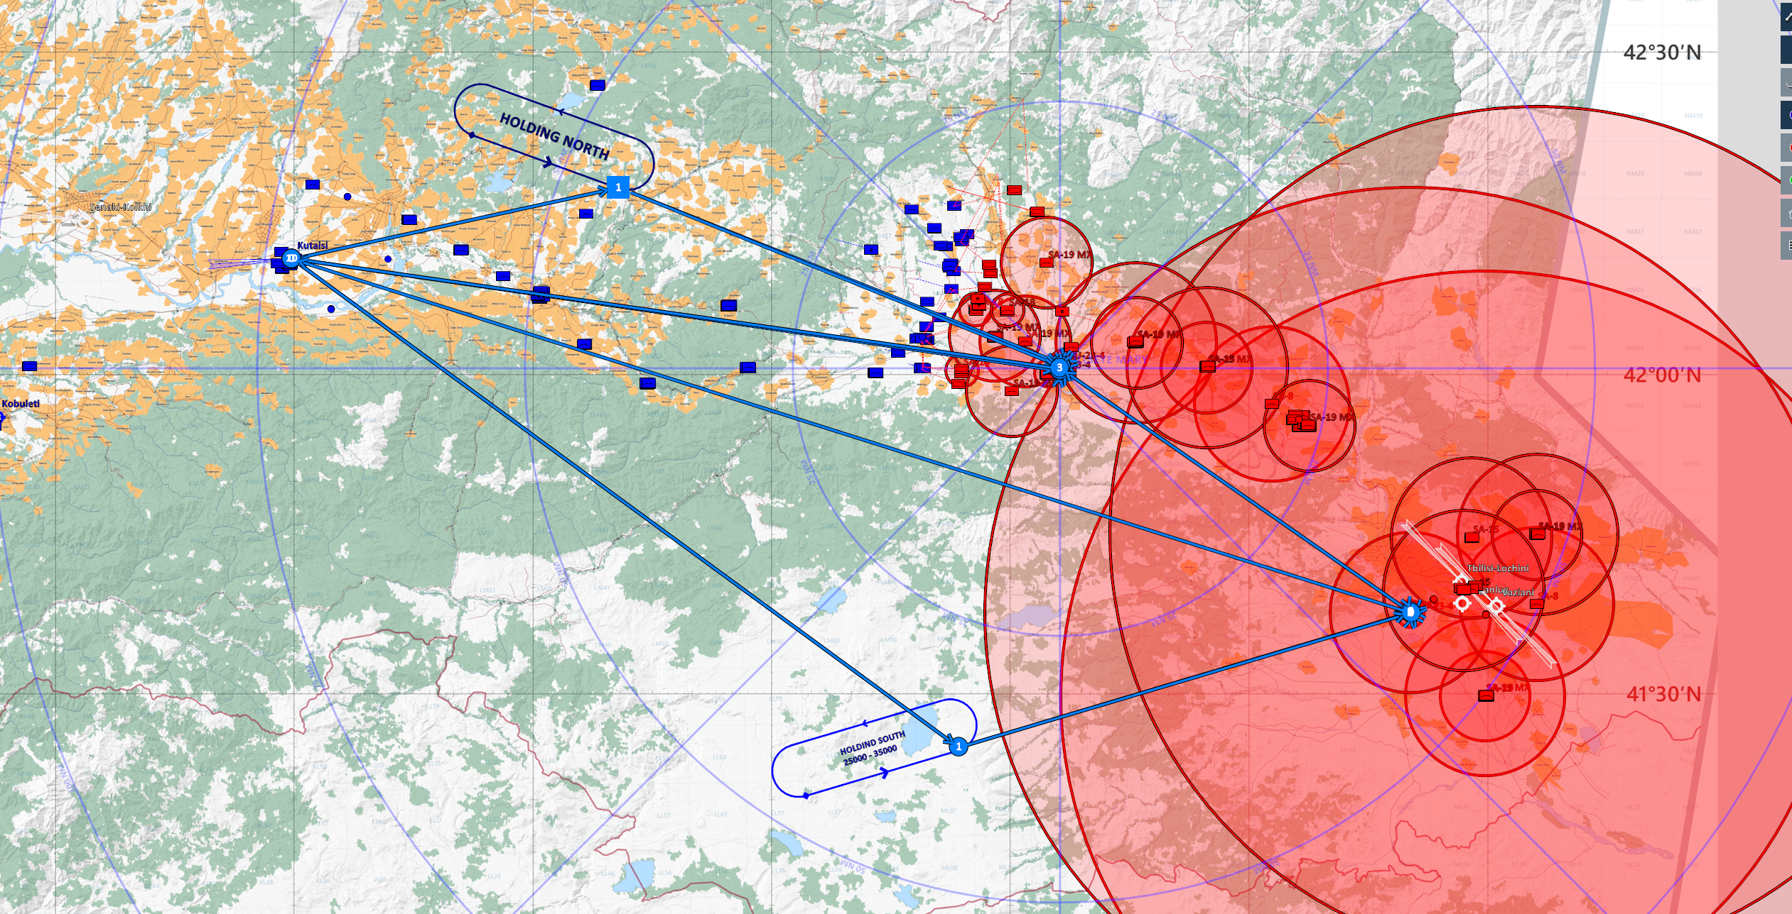

ROUTE OVERVIEW
BE (GORI)

Slide 10
DEPARTURE FLOW
KUTAISI
TOMCAT1 – T/O: 16:15
VIPER1 – T/O: 16:17
HORNET1 – T/O: 16:19
WARTHOG1 – T/O: 16:21
COBRA1 – T/O: 16:23
BASE OPS
251.000

Slide 11
TANKER FLOW
ARCO (2Y)
TEXACO (1Y)
VIPER1
WARTHOG1
TOMCAT 1
HORNET1
COBRA1
BASE OPS
251.000

Slide 12
GAMEPLAN
COBRA
TOMCAT
VIPER
HORNET1

Slide 13
TARGET AREA FLOW
PAQUETE “EL LUNES TE PAGO”
HOLD/PUSH: WPT 1
PUSH TIME:
TOMCAT1 16:35
VIPER1 16:37
HORNET1 16:40
COBRA1 16:40
WARTHOG1 16:40
TOT DEPENDS ON A2A THREAT
TACTICAL FREQ
229.000

Slide 14



PACKAGE FLOW
INGRESS
WARTHOG 1
COBRA 1
HORNET 1
VIPER 1
TOMCAT 1

Slide 15
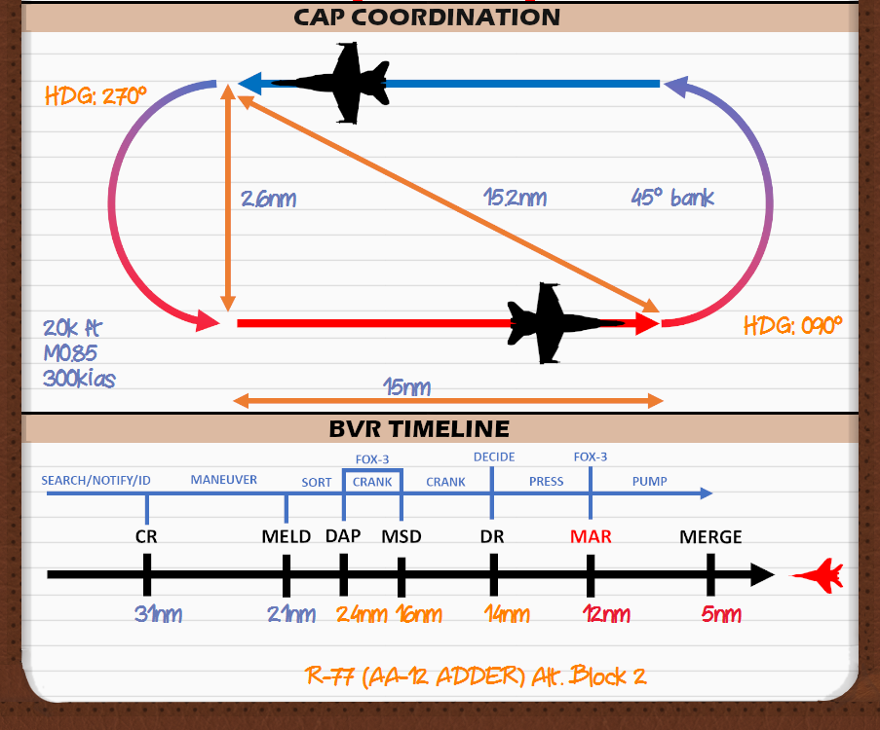
AIR TO AIR PLANNING

Slide 16
RECOVERY PROCEDURES
KUTAISI METAR:
VIS 3-5KM RA OVC LYR 6/18 19/21 SCT34
FUEL EMERGENCY-WOUNDED BIRD

Slide 17
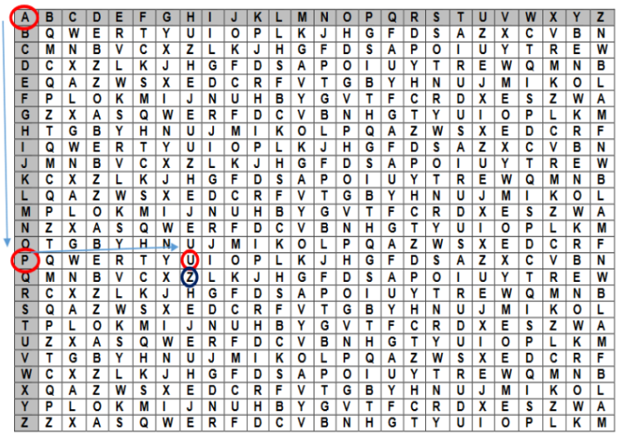
AUTHENTICATION
RAMROD: MURCIELAGO
AMSL1800

Slide 18
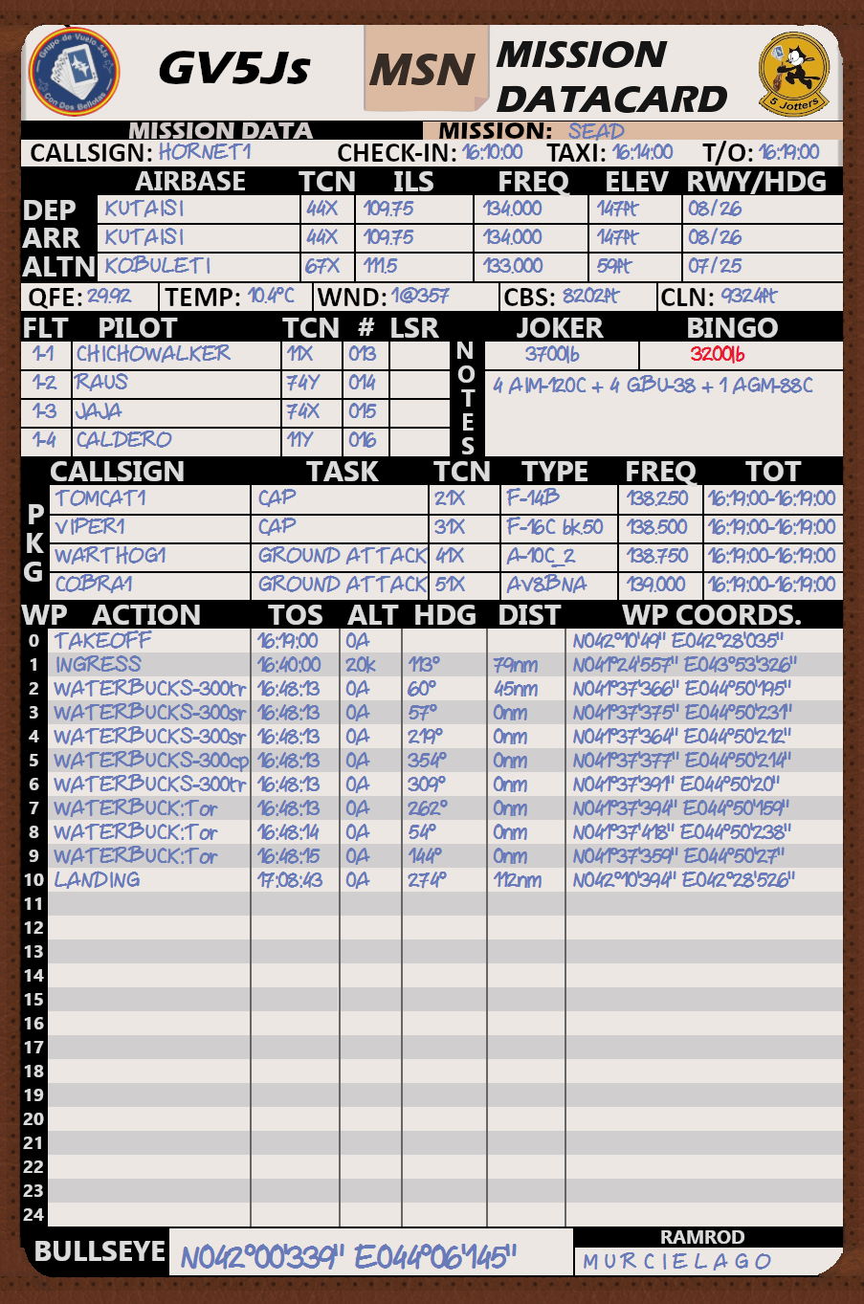
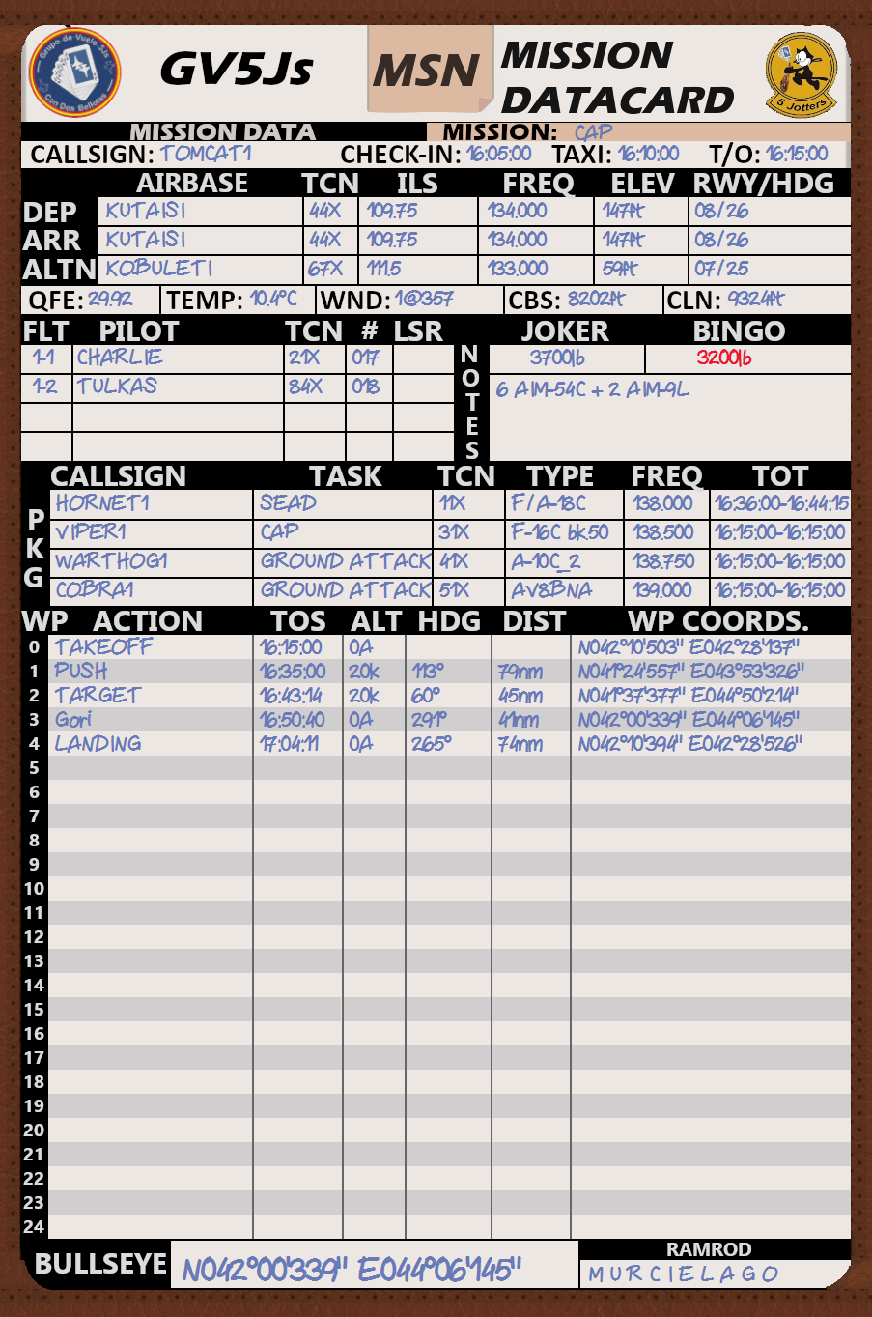
KNEEBOARD IINFO

Slide 19
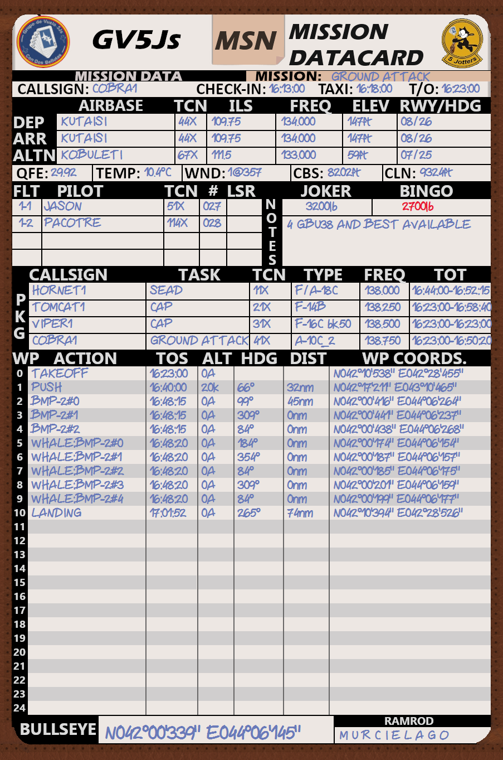


KNEEBOARD IINFO

Slide 20
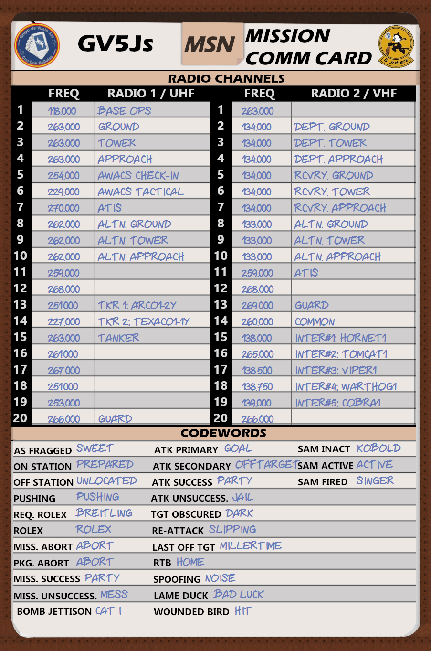
KNEEBOARD IINFO

Slide 21
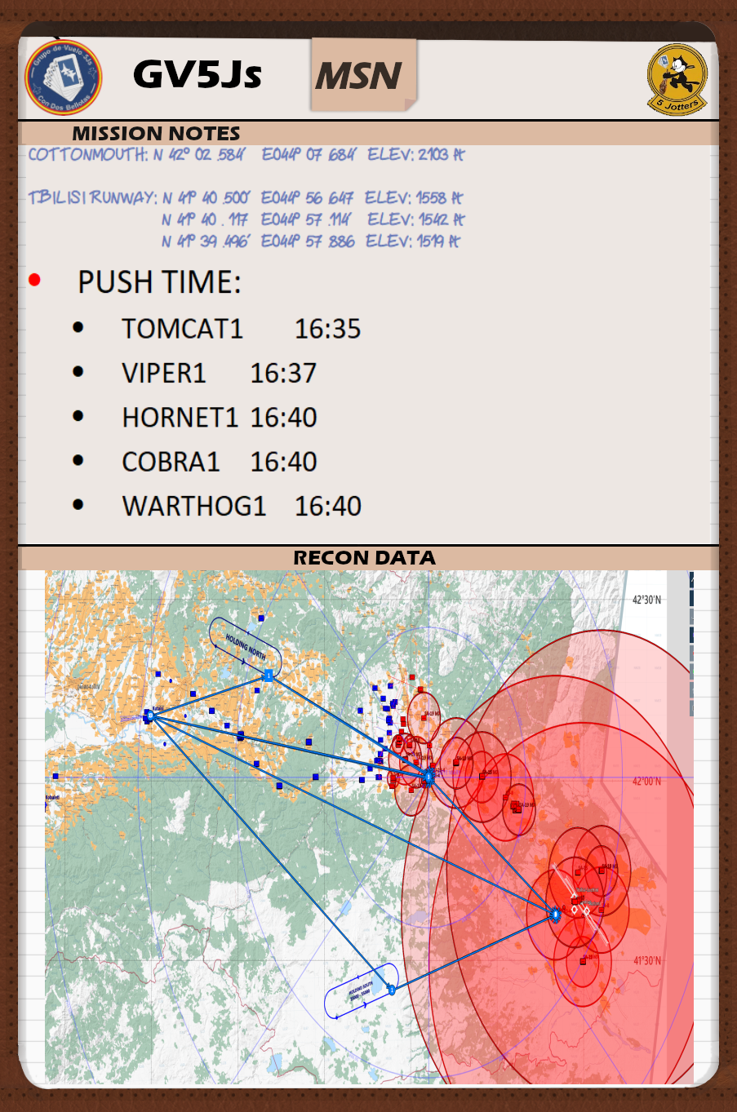
KNEEBOARD IINFO

Slide 22
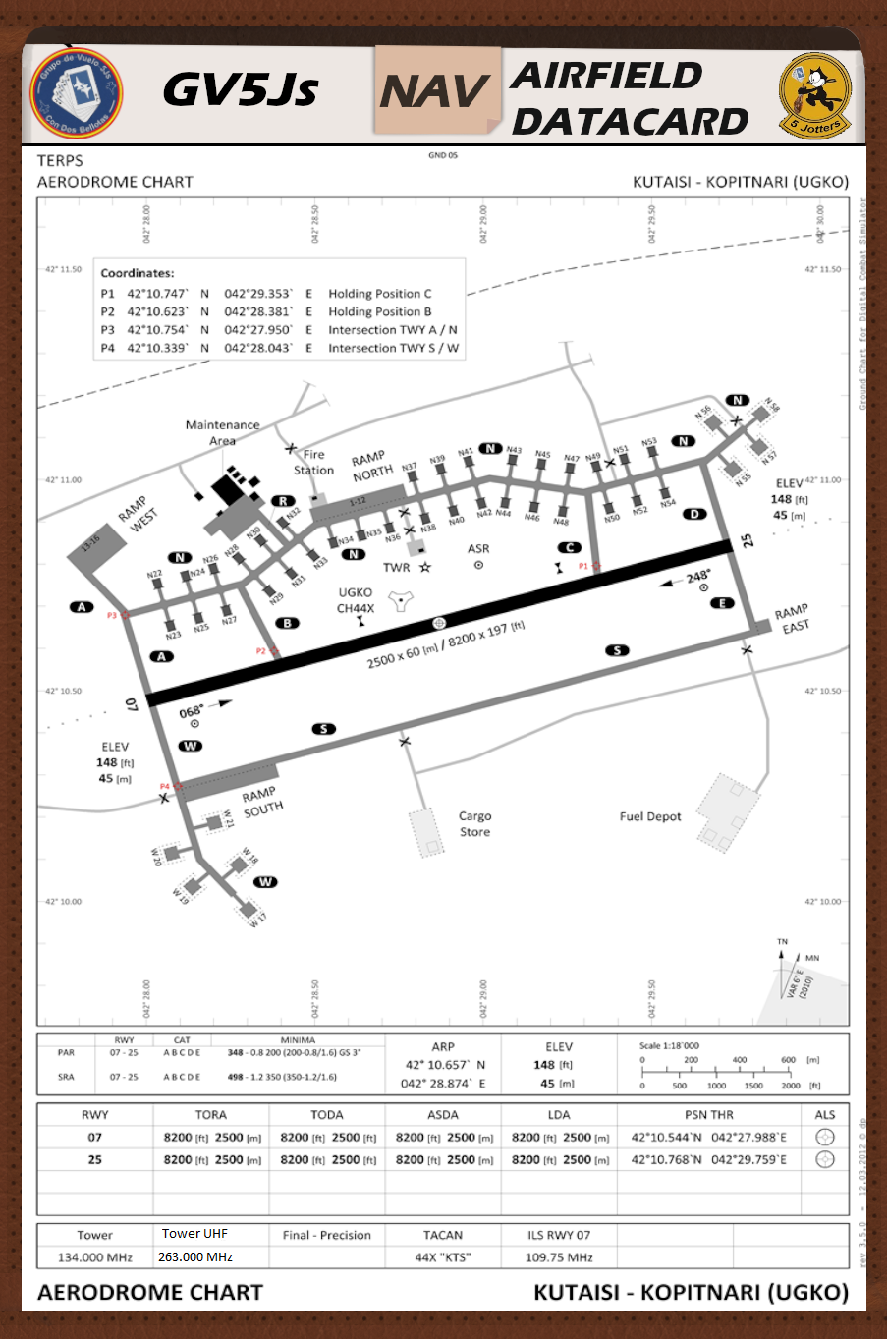
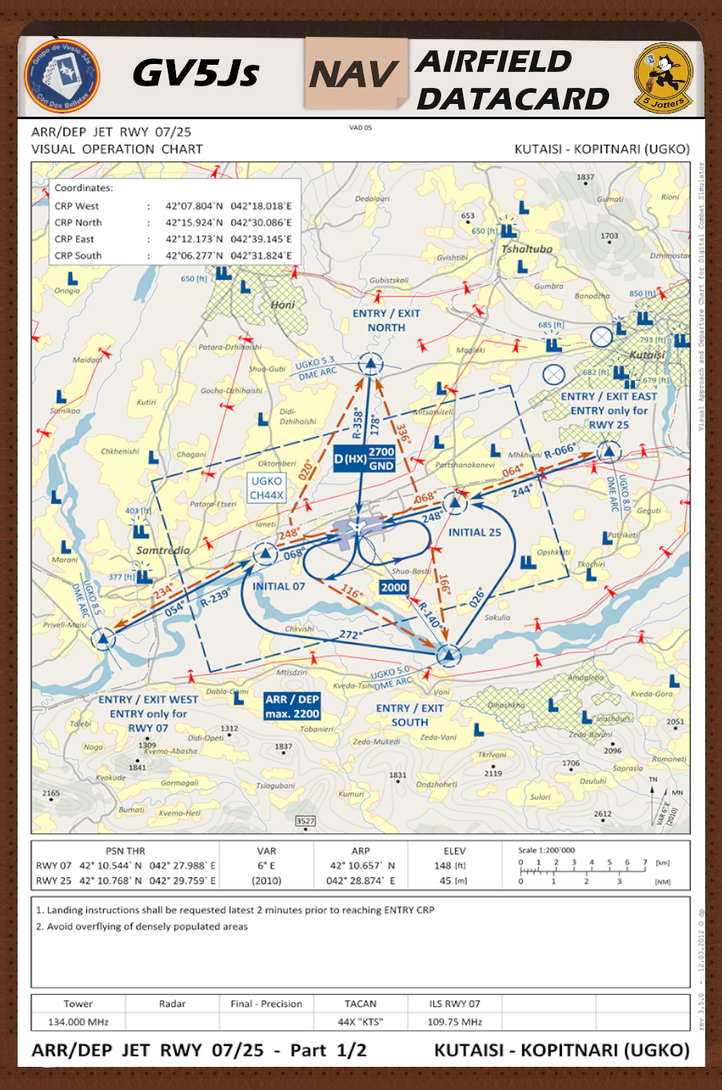
KNEEBOARD IINFO

Slide 23
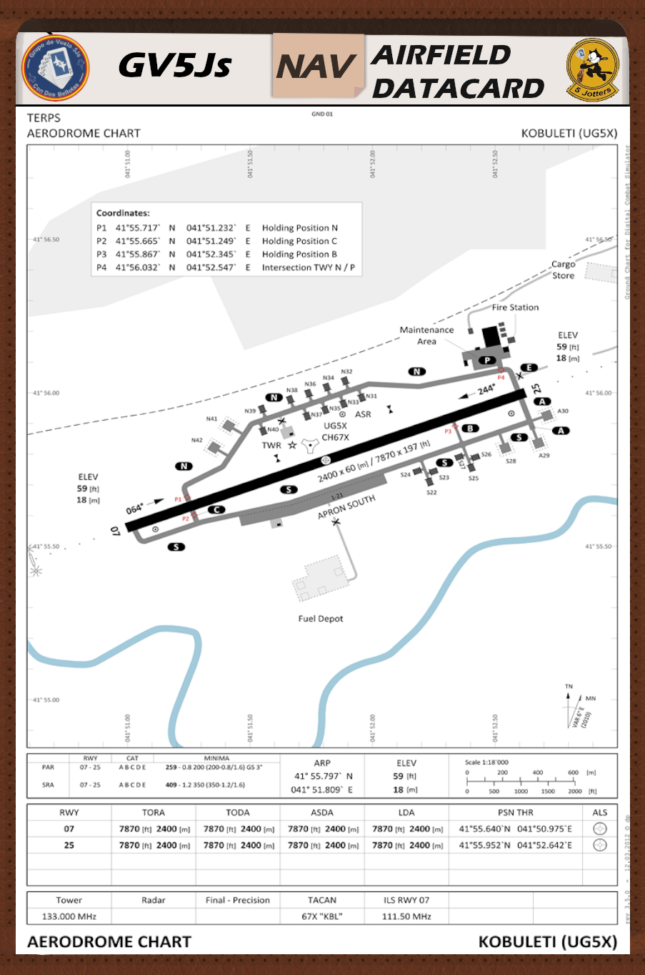
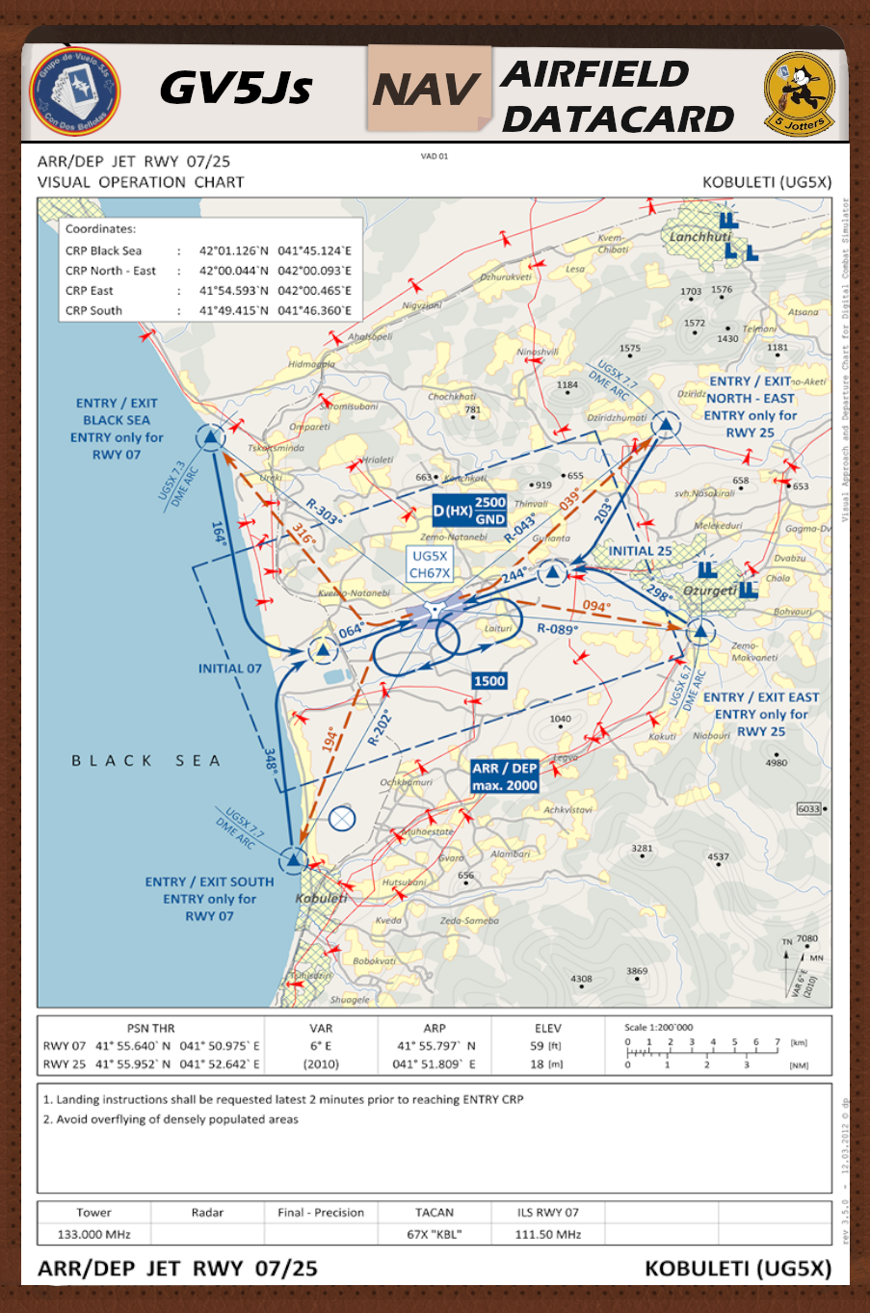
KNEEBOARD IINFO

Slide 24
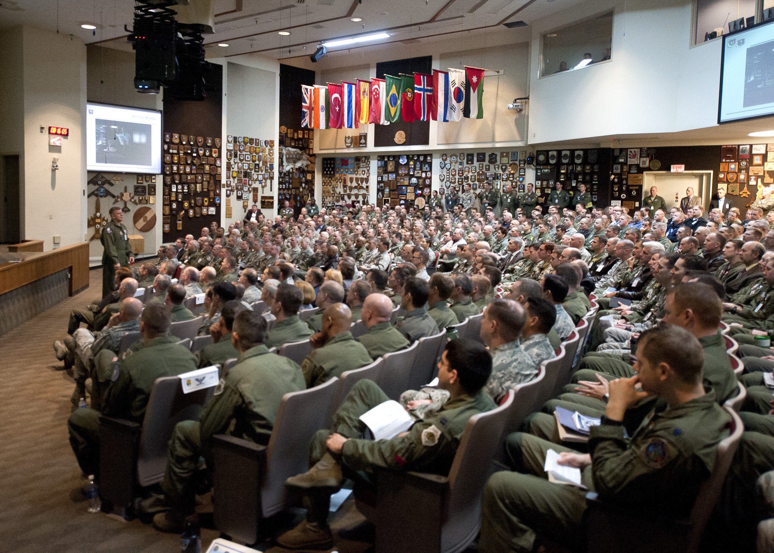
Q?

Slide 25
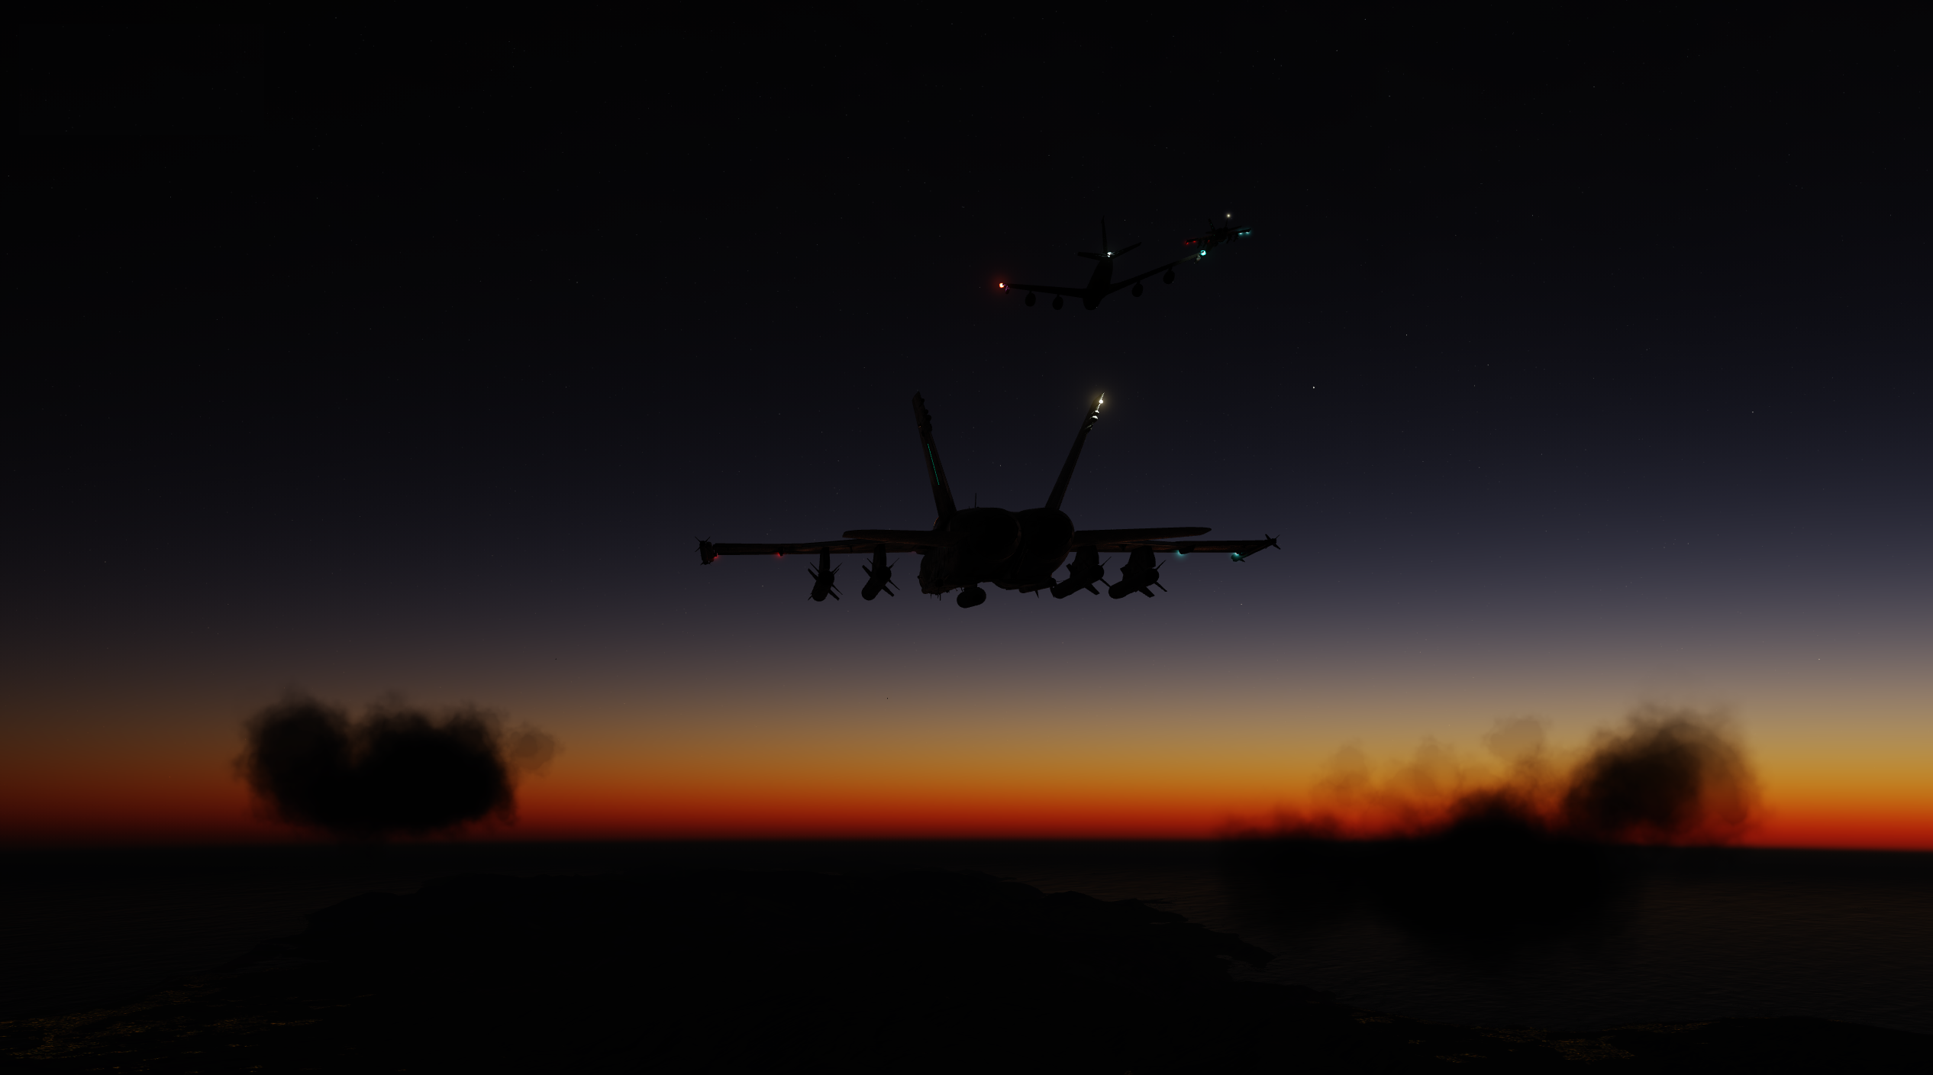
GOOD HUNT!!

